Slide 1
Module 3 OpenStack Compute and Storage

Slide 2
Introduction
The compute servers are the heart of the cloud computing service.
They provide the resources that are directly used by the end users.
A compute node will be the space where the virtual machine will run.
The compute service is composed of multiple components that take care of receiving the request, and launching and managing the virtual machines.

Slide 3
The compute service components
Various building blocks of the compute services are as follows:
The nova-api
Interacts with the user API calls that manage the compute instances.
It communicates with the other components of the compute service over the message bus.
The nova-scheduler
listens to the new instance request on the message bus.
Select the best compute node for the new instance.

Slide 4
The nova-compute
Responsible for starting and terminating the virtual machines.
Runs on the compute nodes and listens for new requests over the message bus
The compute nodes are not provided direct access to the database.
The database access are handled by the nova- conductor service.
Metadata service used to initialize and configure the instance.
nova-consoleauth daemon provides authentication for VNC.

Slide 5
Deciding on the hypervisor
The hypervisor is the heart of your OpenStack compute node.
This is called the virtual machine monitor (VMM)
It provides a set of manageability functions for virtual machines to access the hardware layer.
Wide range of VMMs that it can offer, including KVM, VMware ESXi, QEMU, UML, Xen, Hyper-V, LXC, bare metal, and lately, Docker.
.

Slide 6
Para-virtualization is an improvement of virtualization technology in which the guest operating system needs to be modified to run on the hypervisor. Xen and IBM adopted this technology.
Complete virtualization, in which the hypervisor simulates a hardware platform and is able to run an operating system unmodified.
KVM is the default hypervisor for OpenStack compute.
KVM is best suited for workloads that are natively stateless using libvirt.

Slide 7
The Docker containers
A container provides an isolated user space to host an application.
Containers are providing an encapsulation mechanism.
This encapsulated application runtime environment can be packaged into portable images.
The advantage of this approach is that an application can be delivered along with its dependency and configuration as a self- contained image:

Slide 8
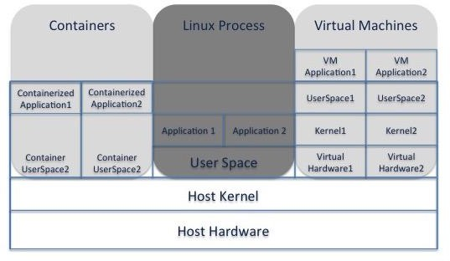

Slide 9
Docker helps enterprises deploy their applications in highly portable and self-sufficient containers, independent of the hardware and hosting provider.
It brings the software deployment into a secure, automated, and repeatable environment.
Docker is based on containers that are not a replacement for virtual machines, but which are very specific to certain deployments.
Containers are very lightweight and fast.
Good option for the development of new applications and even to port older applications faster.
Can save the state of a container as an image that can be shared through a central image registry.

Slide 10
OpenStack Magnum project
OpenStack Magnum project provides Container-as-a-Service capability.
Unlike virtual machines, containers running a single process require:
to be spawned in groups,
network connectivity for communication between collaborating processes.
Storage requirements too.
This is the main idea behind Magnum project.

Slide 11
Magnum is built to support orchestration of groups of connected containers using a Container Orchestration Engine (COE) such as Kubernetes, Apache Mesos, Docker Swamp, and so on.
Magnum works by first deploying the COE nodes.
And then launching groups of containers for deploying applications on these nodes.
COE system acts as an orchestrator to launch applications across multiple containers.

Slide 12
COE Nodes are deployed as Nova instances.
It uses the Neutrons networking service to provide network connectivity between the COE nodes.
The connectivity between the application containers is handled by the COE itself.
Each of the COE nodes is connected to a Cinder volume that is used to host the application containers.
Heat is used to orchestrate the virtual infrastructure for COE.

Slide 13
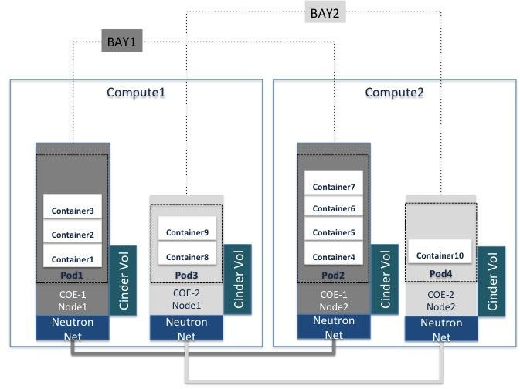
Typical Magnum installation

Slide 14
Components of Magnum Project
Bay
Group of nodes that run COE software.
The nodes can run an API server or minions.
Pod
Group of containers running on the same node.
The Service that consists of one or more Bays that provide to a consumable service.

Slide 15

BayModel
It is a template that can be used to create a Bay.
Similar to the concept of Nova flavor that is used to create a virtual machine instance.

Slide 16
Segregating the compute cloud
As your cloud infrastructure grows in size, need to maintain low latency in the API services and redundancy of your service.
OpenStack Nova provides several concepts that help you segregate the cloud resources.
Tools are available with an OpenStack cloud operator to manage the need for scale and availability of compute servers.

Slide 17
Availability Zone (AZ)
AZ used to group together compute nodes based on fault domains.
Availability Zones maps to the concept of hardware failure domains.
For example, all compute nodes hosted on a rack in the lab. There may be a fault domain as they depend on a single infrastructure resource.
With availability zones configured, the end users can still continue to launch instances just by choosing a different availability zone.
To configure an availability zone for a compute node, edit the /etc/nova.Conf file on that node and update default_availability_zone value.

Slide 18
Host Aggregates
Strategy of grouping together compute nodes that provides compute resources with specialized features.
Attaching a set of metadata to the group of hosts can create the Host Aggregates.
To use a Host Aggregate, the end user needs to use a flavor that has the same metadata attached.

Slide 19
Nova cells
Nova cells are a way of scaling your compute workload by distributing the load on infrastructure resources, such as databases and message queues, to multiple instances.
The Nova cell architecture creates groups of compute nodes that are arranged as trees, called cells.
Root of tree is the API cell – it runs the Nova API service but not Nova Compute service
Other nodes are called Compute nodes which run all Nova services.
Nova API service receives the user input from all other components of Nova compute.
The interaction between the Nova API and other Nova components is replaced by message-queue-based RPC calls.

Slide 20
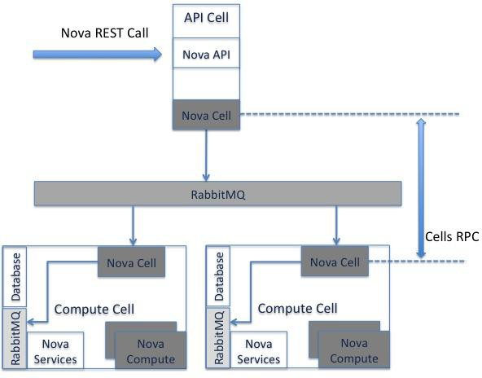
The compute cell launches the instance by scheduling it on a compute node:

Slide 21
Scheduling of an instance requires two levels of scheduling.:
The first level of scheduling is done to select the cell that should host the new virtual machine.
The second level of scheduling selects the compute node to host the virtual machine.

Slide 22
Regions
Nova regions take an orthogonal approach and allow multiple Nova API endpoints to be used to launch virtual machines.
Different Nova regions of an OpenStack cloud share the same Keystone service for authentication and advertising the Nova API endpoints.
The end user will have to select the region where he wants the virtual machines to be launched.
The contrast between cells and regions is that Nova - cells implementation uses RPC calls, while regions use REST APIs to provide segregation.

Slide 23
Workload segregation
Usability feature of OpenStack cloud.
Workload segregation with affinity policy is used to place your instances relative to each other.
To use workload segregation, the Nova filter scheduler must be configured with Affinity filters.
Use the Nova client to create server groups.
The server group can be created with an affinity or anti-affinity-based policy .
The affinity policy places the virtual machines on the same compute node while the anti- affinity policy forces the virtual machines onto different compute nodes.

Slide 24
Changing the color of the hypervisor
OpenStack provide a choice of more than one hypervisor. This will help the end user resolve the challenge of native platform compatibility for their application.
The term integration on the hypervisor level refers to the OpenStack driver that will be provided to manage vSphere by nova-compute.
vCenter can be managed by the OpenStack compute nodes only if a management vSphere cluster is created outside the OpenStack cluster.
VMs are spun up on their specific vSphere cluster, which exposes more hardware requirements.
An individual compute node always runs a single hypervisor.

Slide 25
Overcommitment considerations
In many cases, the physical compute nodes you purchase might be more powerful than is needed.
To avoid such waste, you should keep in mind that sizing your compute nodes is important.
The art of memory or CPU overcommitment is a hypervisor feature, allowing the usage of more resource power by the virtual machine than the compute host has.
Just calculate the portion of physical memory not used per virtual machine and assign it to one that may need more RAM at certain moments.
It is based on the dynamic relocation of unused idle resources.

Slide 26
The CPU allocation ratio
The default CPU allocation ratio is 16:1
Means that you can run a maximum of 16 virtual CPU cores for every physical CPU core within all running virtual machines.
The calculation formula to determine how many virtual instances can run on a compute node is as follows:
(CPU overcommitment ratio * Number of physical cores)
Number of virtual cores per instance

Slide 27
The RAM Allocation ratio
The default memory allocation ratio is 1.5:1
Means that allocating instances to compute nodes is still possible if the total instance memory usage is less than 1.5 times the amount of physical memory available.
Flavors in OpenStack are a set of hardware templates that define the amount of RAM, disk space, and the number of cores per CPU.
Bear in mind that collecting resource utilization statistics is essential and will eventually conduct a better ratio update when needed.

Slide 28
Storing instances‘ alternatives
Approaches to sizing disk capacity of compute nodes.
External shared file storage
The disks of running instances are hosted externally and do not reside in compute nodes.
Advantages :
Ease of instance recovery in the case of compute - node failure
Shared external storage for other installation purposes
Drawbacks :
Heavy I/O disk usage affecting the neighboring VM
Performance degradation due to network latency

Slide 29
Internal non-shared file storage
Advantages:
Unlike the first approach, heavy I/O won’t affect other instances running in different compute nodes
Performance increase due to direct access to the disk I/O
Disadvantages :
Inability to scale when additional storage is needed
Difficulties in migrating instances from one compute node to another
Failure of compute nodes automatically leading to instance loss
Adopting the external shared file storage would be more convenient for our OpenStack deployment.

Slide 30
Understanding instance booting
Launching an instance on your OpenStack cloud requires interaction with multiple services.
When a user requests a new virtual machine, behind the scenes:
The user request must be authenticated.
A compute node with adequate resources to host the virtual machine must be selected.
Requests must be made to the image store to get the correct image for the virtual machine
All the resources required to launch the virtual machine must be allocated.
These resources include network connectivity and storage volume allocation.

Slide 31
Understanding the Nova scheduling process
Nova scheduling is one of the critical steps in the process of launching the virtual machine.
It involves the process of selecting the best candidate compute node to host a virtual machine.
The default scheduler used for placing the virtual machine is the filter scheduler that uses a scheme of filtering and weighting to find the right compute node.

Slide 32
The scheduling process consists of going through the following steps:
The virtual machine flavor itself describes the kind of resources that must be provided by the hosting compute node.
All the candidates must pass through a filtering process to make sure they provide adequate physical resources to host the new virtual machine. Any compute node not meeting the resource requirements is filtered out.
Once the compute nodes pass the filtering process, they go through a process of weighting that ranks the compute nodes according to the resource availability.

Slide 33
Booting from image
The hardware requirements can be selected by choosing the correct machine flavor.
Flavors provide the hardware definition of a virtual machine.
To boot the VM, the compute node must download the image that needs to be loaded on the instance.
Same image could be used to launch multiple virtual machines.
The image is always copied to the hypervisor.
The VM image forms the first hard drive of the instance. Additional hard drives can be added by using the block storage service.

Slide 34
Getting the instance metadata
Virtual Machines must be provided with initialization data that will be used to configure the instance.
Early initialization data configures the instance with information such as hostname, local language, user SSH keys, and so on.
It can be used for repository configuration or set up automation tools.
Initialization data can be metadata associated with the instance or user-provided configuration options.
The cloud images are packaged with an instance initialization daemon called cloud-init.

Slide 35
The EC2 source is the most widely used data source.
user-data is customized user information that can be injected to an instance during boot time.
It can be in form of the script shell or userdata file
A file named custom_userdata_var can be created and injected when creating the instance.

Slide 36
Add a compute node
Using OpenStack Ansible (OSA), adding a compute node is much simpler.
The compute node will run nova-compute together with the networking plugin agent.
Deploying compute nodes using Ansible can be achieved by revisiting the same Ansible configuration files as follows:
Adjust the /etc/openstack_deploy/openstack_user_config.yml file
Additional settings can be added to our compute node, including the type of hypervisor, CPU, RAM allocation ratio etc.

Slide 37
Install the containers in the target compute node by running the setup- hosts.yml Playbook under /etc/openstack_deploy/.
Optionally, it is possible to monitor the new compute node using the telemetry service.
For a more refined update of the OpenStack infrastructure, we can instruct Ansible to deploy the new service only in the compute_hosts group added previously in the openstack_user_config.yml file

Slide 38
Planning for service recovery
Building an infrastructure and starting in production without a disaster recovery background is considered highly risky and you will need to start taking immediate action.
Example: VMware backup solution.
Backing up the cloud controller will be centered on configuration files and databases.

Slide 39
Backup with backup-manager
The backup-manager tool is a simple command-line backup that is available for most Linux distributions.
You can install it on your nodes and configure it easily from one central file.
The main configuration file for backup-manager is /etc/backup-manager.conf.
You can edit the file by defining each section by the backup methods and their associated variables.
Then, we specify the backup methods, such as mysql.

Slide 40
Simple recovery steps
Stop all the services that you intend to recover.
$ stop glance-api
$ stop glance-registry
Import the Glance backed-up database:
$ mysql glance < glance.sql
Restore the Glance directories:
$ cp -a /var/backups/glance /glance/
Start all Glance services:
$ service start mysql
$ glance-api start
$ glance-registry start

Slide 41
Data protection as a service
Used to support tenants to easily back up entire clusters in OpenStack by means of external storage such as NetApp SolidFire.
Other implementations consider using object storage as a backup location for files and archives.
That will require regular snapshots of the instances.

Slide 42
The OpenStack community
Proposed project named Raksha .
Aims to provide a non-disruptive, flexible, and application-aware backup solution destined to OpenStack.
Includes possibilities to perform full and incremental backup of instances to an object storage endpoint.
Another new project for backup and disaster recovery services is the Freezer.

Slide 43
OpenStack Storage
A large cloud deployment requires a reliable, scalable, and robust storage solution.
Storage types:
Ephemeral storage
Persistent storage

Slide 44
Ephemeral storage
Non- Persistent Storage
A user will lose the associated disks once the VM is terminated.
When a tenant boots a virtual machine on an OpenStack cluster, a copy of the glance image is downloaded on the compute node.
This image provides the ephemeral storage.
Anything stored on this disk will be lost once the Nova instance is terminated.

Slide 45
Persistent storage
The storage resource is always available.
Powering off the virtual machine does not affect the data .
We can divide persistent storage in OpenStack into three options:
- object storage(Swift)
- file share storage(Manila)
- block storage(Cinder)

Slide 46
Object storage is not NAS/SAN
Object storage can scale infinitely and can better handle node failure without data loss unlike traditional NAS or SAN.
The data are stored as binary large objects (blobs) with multiple replicas .
The objects are stored in a flat namespace.
Accessing the object storage is done using an API such as REST or SOAP.
Object storages are not suitable for high-performance requirements or structured data that is frequently changed, such as databases.

Slide 47
A spotlight on Swift
Swift was one of the first two OpenStack projects.
It was a joint effort of NASA and Rackspace
The development of object based storage systems are fueled by :
The emergence of web and mobile applications
software- defined storage (SDS), which decoupled storage solutions from underlying hardware and enables a large distributed storage system to be built using commodity storage.
Swift is analogous to the service storage service (S3) provided by Amazon web services.

Slide 48
Benefits:
Scalability: Swift is designed as a distributed architecture that provides performance and scalability
On-demand: Swift offers provisioning storage on demand with a entralized management endpoint
Elasticity: The dynamic ways to increase or decrease storage resources as needed

Slide 49
The Swift architecture
Distributed Environment
Scales out and tolerates failures without compromising the data availability.
Prevents any single point of failure(SPOF).
Designed to scale horizontally.

Slide 50
Components of Swift
The Swift proxy server: This accepts the incoming requests via object API or raw HTTP.
The proxy server: Rely on caching, which is usually deployed with memcached to improve performance.
The account server: This manages the account. A Swift account is equivalent to a tenant on OpenStack.
The container server: A container refers to the user-defined storage area within a Swift account. It maintains a list of objects stored in the container.
The object server: It manages an actual object within a container.

Slide 51
Indexing the data
Done via the extensive usage of metadata.
metadata in object storage device (OSD) are stored with the object itself in key- value pairs.
A rich API access
Swift proxy is used to communicate and access OSDs.
The libraries provided by swift use HTTP calls to speak to the Swift proxy.
Swift gateways
An additional layer to interact with the storage interfaces.
Traditional access to data such as CIFS or NFS
Filesystem gateway

Slide 52
Physical design considerations
Replica of three (Redundant storage).
Increase availability
Hierarchy of storing data in swift:
Region: Geographically distributed environment, data can be held in multiple nodes that are placed in different regions
Zone: Regions encapsulate zones define the availability level .A grouping or a set of hardware items.
Storage nodes : A set of storage nodes forms a cluster. Runs the Swift processes and stores an account, a container, the object data, and its associated metadata.
Storage device: The storage device can be the internal storage nodes device or connected via an external stack .

Slide 53
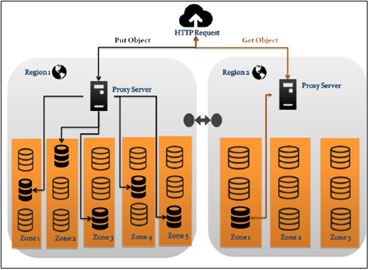

Slide 54
The Swift ring
Define the way Swift handles data in the cluster.
In swift, logical layout of object data is mapped to a path based on the account, container and object hierarchy.
Ring maps these to a physical location on the cluster.
Swift maintains one ring per storage.
The rings are built by using an external tool called the swift-ring-builder.
Each storage drive be divided into 100 partitions.
generic format of the ring builder command:
#swift-ring-builder <builder file> create <part power> <replicas> <min part hours>

Slide 55
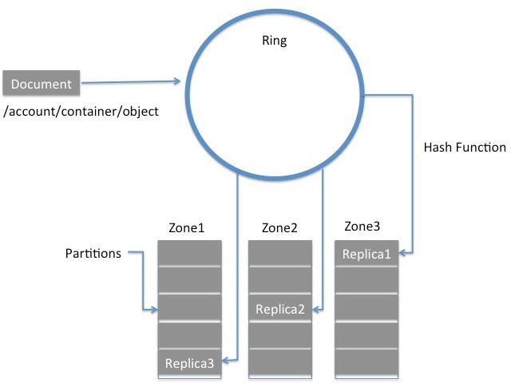

Slide 56
Storage policy and erasure coding
Uses parity to recreate lost data.
When the user uploads a document to the object storage configured with erasure coding, the Swift proxy breaks the uploaded data into segments.
It then calls PyECLib to encode the data into erasure-coded fragments.
The fragments are then streamed to the storage nodes.
This approach can be compared to the RAID levels

Slide 57
Swift hardware
An example of the deployment that we intend to have:
For 50 TB of object storage
Cluster replica of 3
The Swift filesystem is XFS
A hard drive of 2.5 TB
30 hard drive slots per chassis
total storage capacity: 5O * 3 replicas = 15O TB
Cpu cores can be calculated by:
Total_Number_Drives * (core:drive ration))
i GHz_Cores

Slide 58
The Swift network
The front-cluster network: Proxy servers communicate with the external clients over this network.
The storage cluster network: It allows communication between the storage nodes and proxies as well as inter-node communication across several racks in the same region.
The replication network: replication-related communication between the storage nodes.

Slide 59
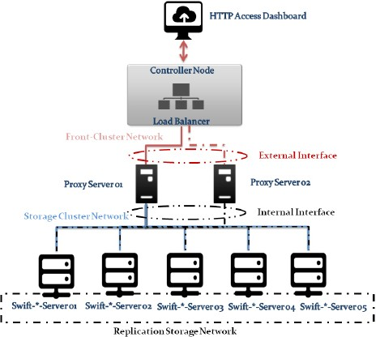

Slide 60
Deploying Swift service
OpenStack Ansible is used to deploy Swift service.
At least three storage nodes with five disk drives. The first step is to add a filesystem to the drives.
Use xfs as our filesystem .
Replace X with the appropriate drive letter.
The filesystem must be created for all five attached drives.
Next make an entry in /etc/fstab to mount the drives on boot.
Don’t forget to create the directory for the mount point.
Finally mount the drives with mount /srv/node/sdX command.
Copy the reference configuration file and make the appropriate changes.
Once the update is done, the Swift playbook can be run

Slide 61
Using block storage service: Cinder
Persistent storage management .
Virtual machines are backed by Cinder volumes can be easily live- migrated and evacuated.
Volumes expose a raw block of storage that can be attached to instances and can store data permanently.
To use the attached volume , it must be first partitioned and laid with a filesystem and mounted on to the filesystem hierarchy .
Helps you manage the quotas by limiting the tenant s usage.

Slide 62
Components of Cinder service:
Cinder API server:
Interacts with the outside world using the REST interface.
It receives requests for managing volumes.
Cinder scheduler:
Responsible for choosing the volume server for hosting new volume requested by the end-users.
Cinder volume server:
Nodes that host the volumes.

Slide 63
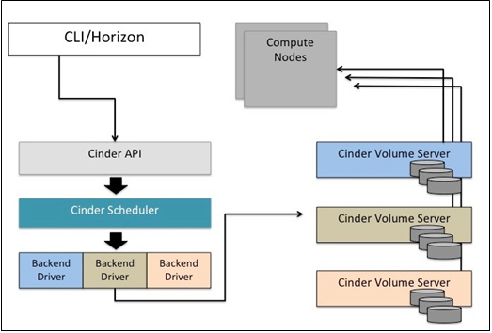

Slide 64
Attaching Cinder Volume to Nova Instances:
Create a Cinder volume by specifying the volume name and its size.
Next, use the volume-attach command to attach the Cinder volume to a Nova instance.
mark the volume as available to the Nova instance itself by using the libvirt library

Slide 65
Cinder backend drivers and scheduling
Cinder provides a pluggable architecture .
LVM- iSCSI backend driver is the default backend driver provided by Cinder.
Cinder can be configured with NFS, GlusterFS and various compatible storage vendors including NetApp and EMC .
Multiple backend drivers can be enabled and used at the same time.
The Cinder scheduler refers the filter and goodness function for each backend to determine the correct backend for a volume request.
End user can request volumes with a specific backend driver.

Slide 66
Deploying Cinder service
OpenStack Ansible provides playbooks to deploy Cinder services.
Adjust the /etc/openstack_deploy/openstack_user_config.yml file to point to where the Cinder API service will be deployed.
Cinder API service can be deployed in the controller nodes by adding the storage-infra_host.
To run the Cinder playbook use the openstack-ansible command as follows:
# cd /opt/openstack-ansible/playbooks
# openstack-ansible os-cinder-install.yml

